Slide 1

Business Intelligence
Group Work presentation: UP2187359, UP2225522, UP2249235, UP2234565, UP2208216

Slide 2
Discussion points:
01:
02:
Task 1 – BPMN
Task 2 – Data Story

Slide 3




MCBK background:
01:
Preamble
Digitalisation of Knowledge
Vision
Knowledge is vital for improving healthcare and individual well-being, necessitating accessible and up-to-date information for informed decision-making.
Rapid scientific advancements demand agile, scalable, and computable knowledge representations to facilitate global dissemination and utilisation
Dedication to mobilising CBK to enhance healthcare, reduce disparities, and ensure accuracy through an open and interoperable ecosystem.

Slide 4
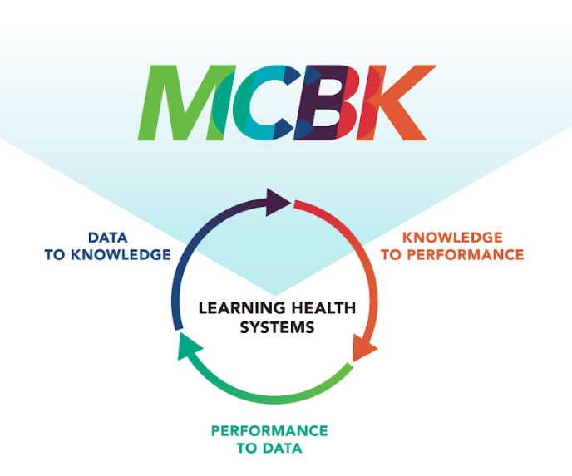
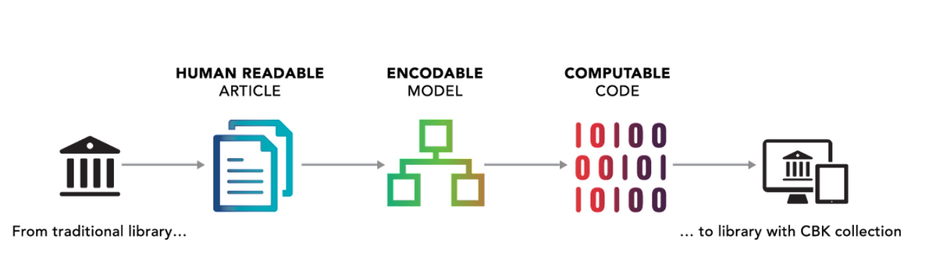
CBK Ecosystem Concept

Slide 5
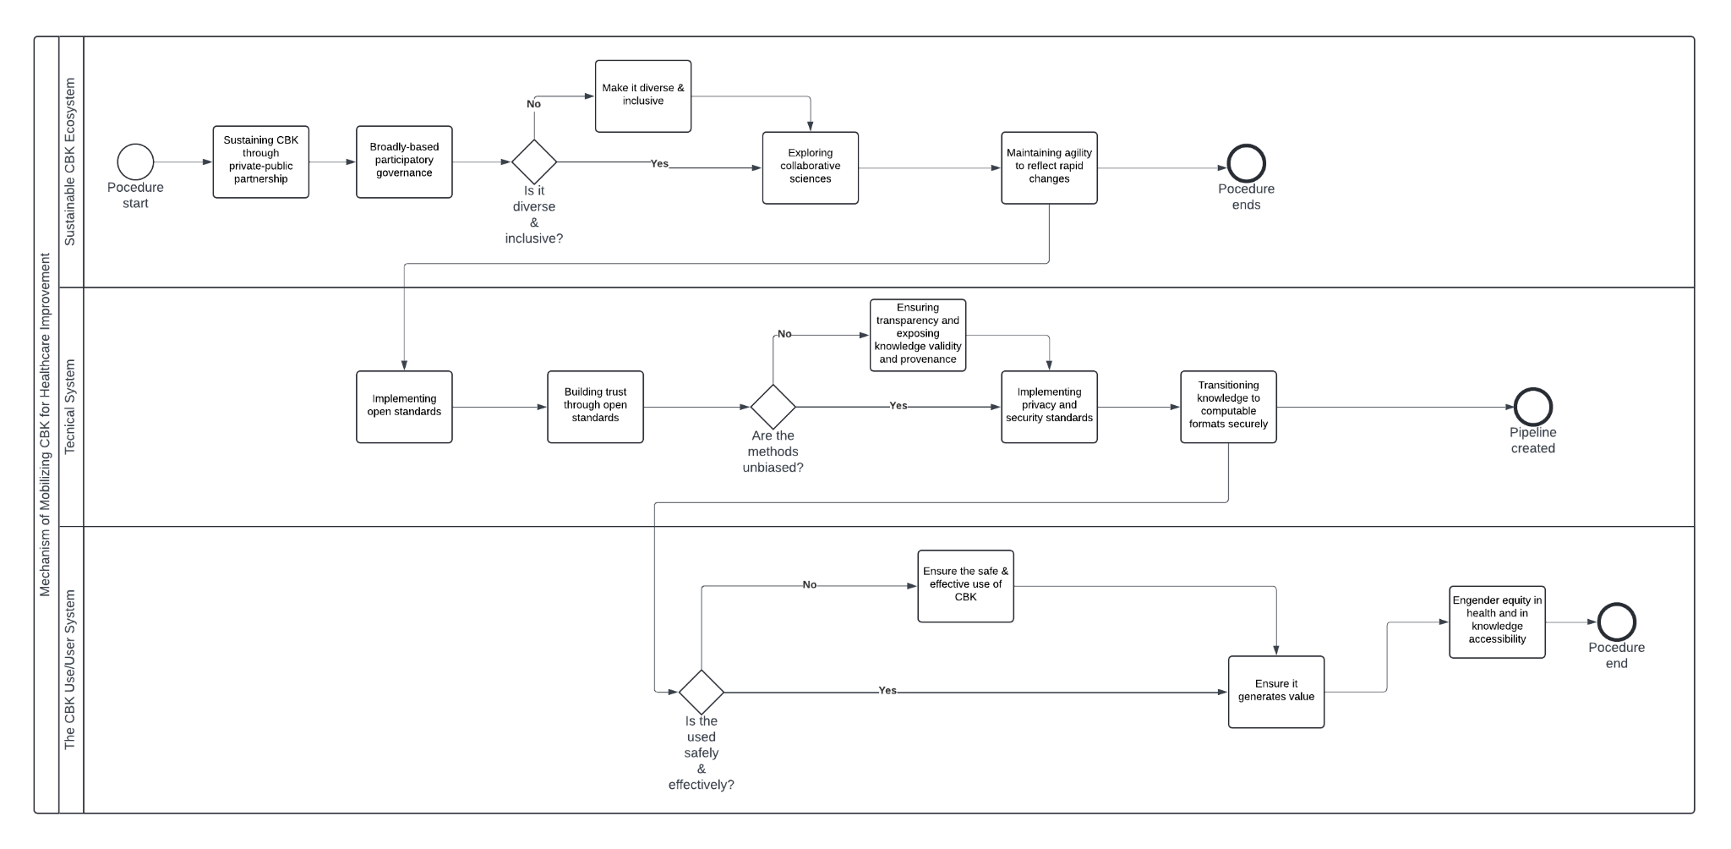

Slide 6

Introduction
02:
Motivation & Relevancy
Aims and Objective
S
ocial Impact: Recognizing the societal impact of road traffic crashes on individuals, families, and communities have motivated the choice of this topic.
lobal significance: Road safety is a concern for every country, irrespective of its level of development.
Explore the limitations and challenges associated with global road safety data collection
Assist Policy Makers
Educate & Raise road safety concerns
G

Slide 7

Background of the Dataset
Data Source:
The datasets are all from the World Health Organization (WHO) and include global road mortality data. It can be sourced from:
Collaborative initiatives
National governments
International databases
Research studies
Surveys and surveillance systems
Limitations:
Quality control
Data Lag
Underreporting
Data granularity

Slide 8
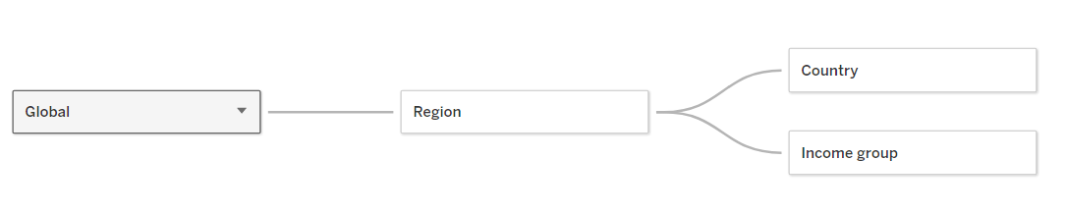
Dataset Definitions
Estimated road traffic death rate (per 100,000 population)
The data is cleaned and saved for further exploration
Data modelling is done
Important variables
Dimension (Global, Region, Country, Income Group)
Year (2000 – 2019)
Indicator Value (Estimated road traffic death rate )
Sex (filtered to include both)

Slide 9
References :
World Health Organization. (2023, December 13). Global status report on road safety 2023.
https://www.who.int/publications/i/item/9789240086517
World Health Organization. (2023, December 13). Road traffic injuries.
https://www.who.int/news-room/fact-sheets/detail/road-traffic-injuries
World Health Organisation. (2024, March 15).Road traffic mortality. https://www.who.int/data/gho/data/themes/topics/topic-details/GHO/road-traffic-mortality
World Health Organisation. (2024, February 21). WHO Mortality Database. https://www.who.int/data/data-collection-tools/who-mortality-database

